Slide 1
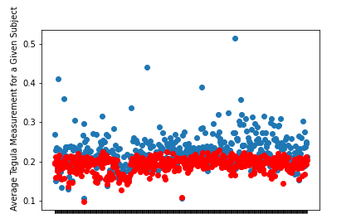
Four Cheadle Center Researchers Conducted their own Measurements and Results were Compared to Contributions by Community Scientists from Notes for Nature
Averaged 13.7% difference between researchers’ average tegula measurement and citizen scientists average tegula measurement.
Statistically significant difference when comparing citizen scientists’ measurements as a whole to researchers’ measurements with an independent samples T-test (P-Value = 6.0 x 10^-46).
Red = researchers
Blue = citizen scientists

Slide 2
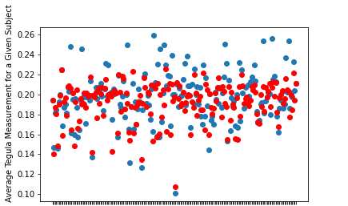
Several Methods were Considered to Improve Accuracy of Data
Biggest change in P-Value derived from considering only certain images.
Remove images that lack precise data from analysis by only considering ones where citizen scientists managed to produce 3+ measurements within 10% of each other.
Only analyze the 193 / 490 images left after this and only consider the measurements that met the 10% criteria.
Compare Researchers’ average measured Tegula Distance to Citizen Scientists’ average measurement for each image.
Average percent difference = 5.24%.
Citizen Scientists measure 2.2% higher than researchers on average.
Statistical significance from independent samples T-test comparing Researchers’ measurements to Citizen Scientists’ (P-Value = 0.033).
Given Subject (Image)

Slide 3
Requiring an image to have 3 measurements (as opposed to 2) within 10% of each other gives confidence that the measurements are truly precise, as opposed to occurring by chance.
Intermediate (“confirmation”) measurement supports the largest and smallest of the three measurements by drastically lowering the probability that such a group occurs randomly.
P-Value of 4.02 * 10^-11 when comparing researchers’ data to community scientists’ data after criteria lowered to 2 measurements within 3% of each other and number of total measurements lowered to 4.
Standards were increased to 3% to reduce the number of images left to 178, a comparable amount of data loss.
P-Value of 0.033 and 193 images left with current standards.
Also reduces chance of conflicting tegula distances.
Conflicting tegula distance = more than one instance of grouped measurements
i.e., measurements [0.19, 0.195, 0.23, 0.27, 0.28] have two different contenders for the correct tegula distance: average of [0.19, 0.195] OR average of [0.27, 0.28]
Assuming a normal distribution and 5 measurements:
30% chance of conflicting tegula distance when looking for 2 measurements within 10% of each other.
1% chance of conflicting tegula distance when looking for 3 measurements within 10% of each other.

Slide 4
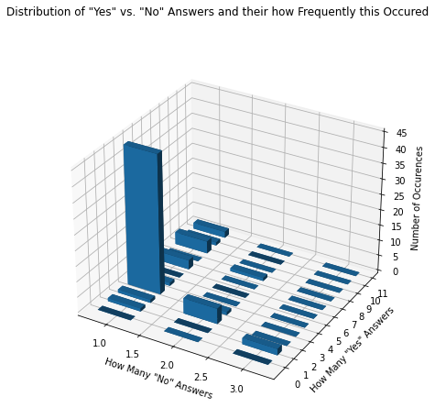
Why did some images have more than five measurements?
Distribution of how many measurements answered “Yes” to “Were you able to measure the bee?“ vs. how many answered “No” for a given image and how frequently this occurred.
Peaks at (1,4), (2,3) and (3,2) indicate 5 total measurements to be the norm despite unconfident answers.
People tend to maintain confidence despite inability to measure certain images properly (such as those with antennae covering a tegula).
We expect unconfident answers to be very prevalent on certain images, but we only ever saw three at most.

Slide 5
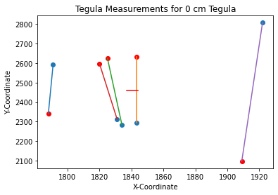
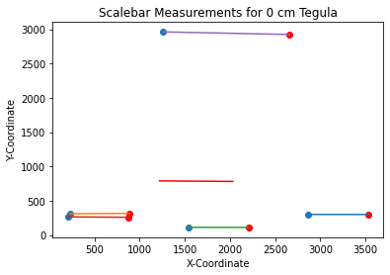
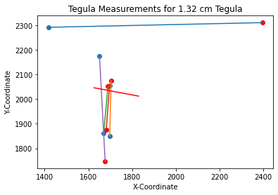
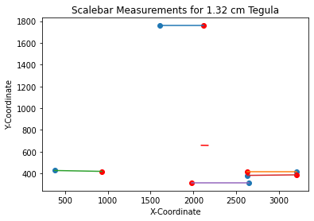
Why did Notes for Nature Reconciled Data Differ so Significantly from ours?
Notes for nature averages all measured X-coordinates and Y-coordinates for a given image, NOT individual measurements (as we do).
This means if some users select the top of the tegula first and some select the bottom first, the reconciled coordinate average will be in the middle
Similarly, users not selecting the exact same block on the scalebar will greatly skew measurements when coordinates are averaged.
Blue point = first coordinate.
Red point = second coordinate.
Red line = line between average of first coordinates and average of second coordinates (reconciled data).
Note: axes are NOT to scale.

